Slide 1
Analyzing and Extending A Wireless Mesh Network Monitoring System
Zhe Wei Chong

Slide 2
Seminar Outline
Project Introduction
Background and Related Work
Project Overview
Current Status
Future Work

Slide 3
Project Introduction
Wireless Meshes are a fairly new research area
You might have heard of it
  City-wide wireless access in London
  Vehicle safety system, CeBIT
Research in topics such as routing protocols, node communications etc. is very active
Monitoring and visualization help determine the overall health of the wireless mesh itself and observe faults in the network

Slide 4
Wireless Mesh Networks
Wireless “ad-hoc” network
Self-organized, self-configuring and self-healing
Mesh nodes and routers help redirect traffic through multiple “hops” to the destination
Benefits
  Requires no existing infrastructure
  Extremely flexible
  E.g. emergency response, community networking

Slide 5
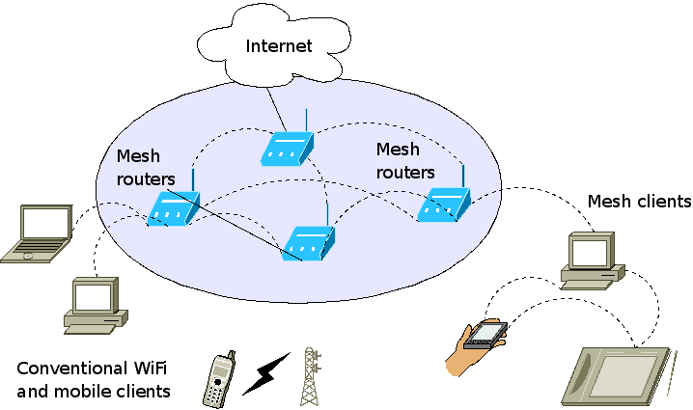
Wireless Mesh Networks
A hybrid wireless mesh network

Slide 6
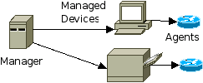
Monitoring
Observing status of the wireless mesh and diagnosing problems
Usually performed in tandem with management tools to maintain network
Simple Network Management Protocol (SNMP)
  Poll each node (agent) from a centralized server (manager) to gather data

Slide 7
Monitoring
Problems
  Not suitable for wireless mesh
  Complicated – nodes are usually mobile
  Does not scale well to large networks
  Limitations of wireless medium
  Impacts performance of mesh, or overload the network

Slide 8
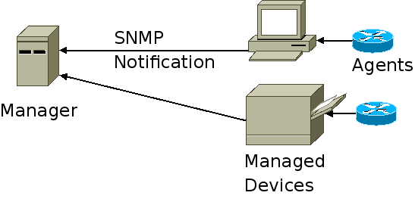
Monitoring
Alternatives
  Distributed approach - Cluster nodes into groups, each one managed separately
  “Push” instead of “Pull” - Send information only if data has changed
Reduces traffic directly between managers and agents

Slide 9
Visualization
Convert monitored data into coherent graphical diagrams
Overall status and traffic flow of the wireless mesh can be clearly seen
Network problems can be instantly pinpointed
We would like to know
  Connectivity
  Bandwidth utilization
  Wireless statistics
  Network topology

Slide 10
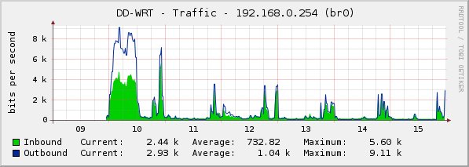
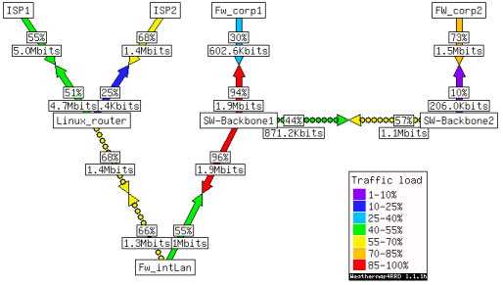
Visualization
Popular
  RRDtool
  Weathermap

Slide 11
Project Overview
Aims
  Building a software stack for wireless mesh monitoring and visualizing
  Efficiency, scalability and ease of deployment
Motivations
  Existing software reuse – portable, modular design
  Not many publicly available visualization tools for wireless mesh networks
  None for multi-radio

Slide 12
Current Status
Completed
  Polling scripts
  Web interface
In Progress
  Exporting router AODV link state
  Propagating via SNMP notifications
  Improved visualization via PHP-Weathermap

Slide 13
Future Work
Testbed
  Testing distributed monitoring efficiency
  Traffic measuring and analysis
  Out-of-band monitoring
Studies on multi-radio multi-channel networks
Node auto-discovery
Client management
Fully configurable web control panel

Slide 14
Project Summary
Wireless mesh networking
  Good potential of replacing traditional communication technologies in the near future
Research gap for monitoring and visualizing wireless
An effective monitoring and visualization solution can improve our ability to troubleshoot the mesh and speed up development

Slide 15
Acknowledgements
Marius Portmann
Dirk Lessner
Ryan Wishart
National ICT Australia

